Slide 1
Advanced Academics at Cooper City High School

Slide 2
Educating Today’s Students to Succeed in Tomorrow’s World
Our goal is to provide each student the preparation necessary for success in college and in the world beyond

Slide 4
Advanced Placement
Endorsed by College Board
Well Established in USA
Exams: multiple choice and free response
Exams administered within the school year
Capstone Diploma
Both advanced and rigorous
Depth and breadth of subject matter
Two quality points weighted GPA
Possible credit by exam – equally accepted by Florida Schools
Must take exams to earn quality points towards weighted GPA
AICE Cambridge
Offered by University of Cambridge
Cambridge Diploma Option
Florida Academic Scholars Award (Bright Futures Scholarship) without SAT/ACT scores
Exams may be outside of school year
No make up exams

Slide 5
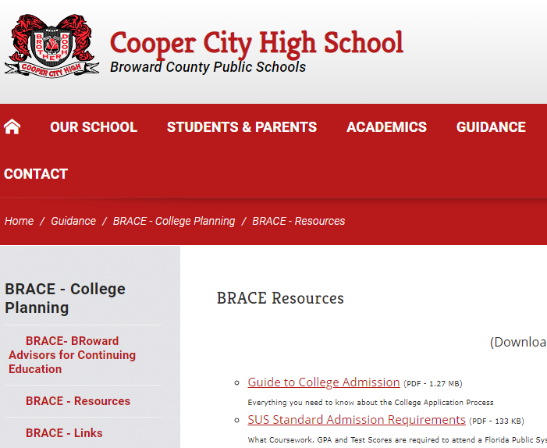
Which One Should I take?
It depends… What Are your interests and strengths?
We offer many rigorous courses at Cooper City High School, both AP and AICE Cambridge – you have a choice
AP Courses- Academic Only
AICE Cambridge – Academic and Electives
Students may take both AP and AICE Cambridge classes simultaneously
Please check on the acceptance of AP/AICE courses at College level-

Slide 6
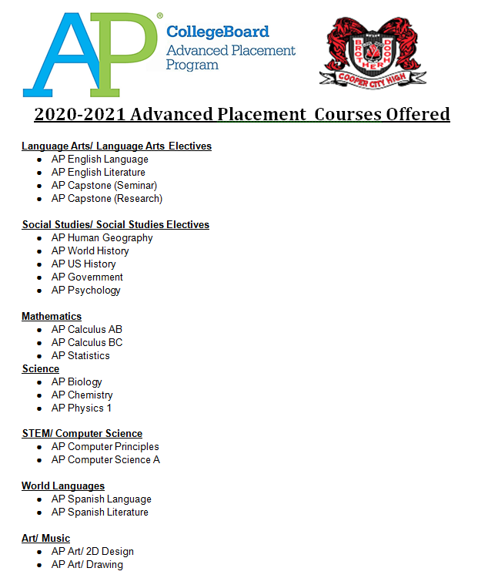
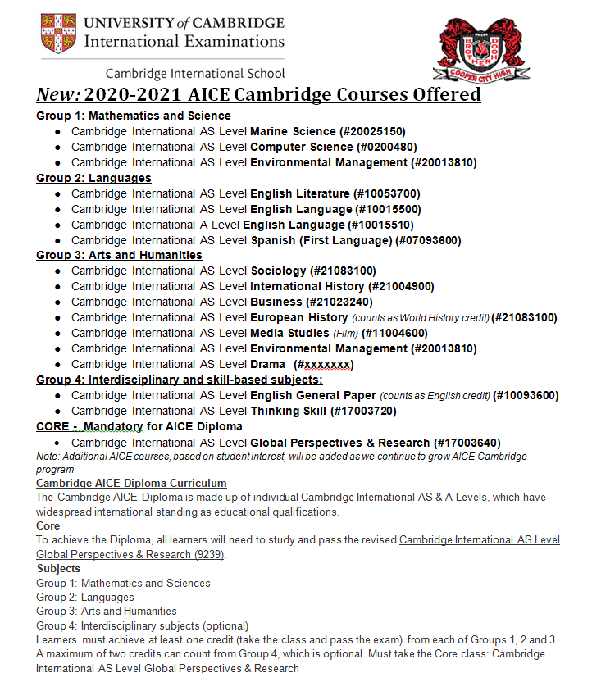

Slide 7
Advanced Placement Course Offerings Cooper City High School 2020-2021
Groups | Courses
1. Mathematics and Science | AP Biology AP Statistics AP Chemistry AP Computer Principles AP Physics I AP Computer Science A AP Calculus AB AP Calculus BC
2. Languages | AP English Language and Composition AP English Literature and Composition AP Spanish Language and Culture AP Spanish Literature
Arts and Humanities | AP Human Geography AP US History AP World History AP Psychology AP US Government AP Studio Art: Drawing, 2D
4. Interdisciplinary | AP Capstone Seminar AP Capstone Research Mastery and passing of AP Capstone Seminar Exam

Slide 8
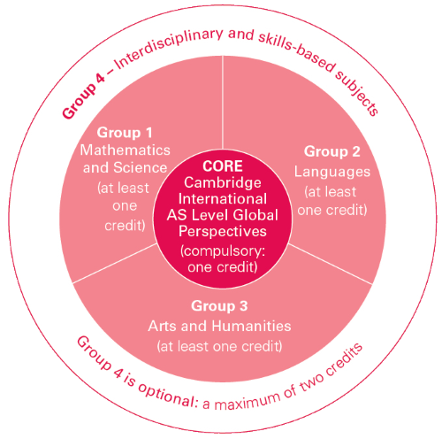
AICE Cambridge Course Offerings Cooper City High School 2020-2021
Group 1: Mathematics and Science
AICE Marine Science AS
AICE Computer Science AS
AICE Environmental Management AS
Group 2: Languages
AICE English Language AS
AICE English Language A
AICE English Literature AS
AICE Spanish Language (First Language)AS
Compulsory Core (Required) AICE Global Perspectives AS
Group 3: Arts and Humanities
AICE Sociology AS
AICE International History AS
AICE European History AS
AICE Media Studies AS
AICE Business AS
AICE Drama AS
AICE Environmental Management AS
Group 4: Interdisciplinary and skill-based subjects
AICE English General Paper AS
AICE Thinking Skills AS

Slide 9
AP Scoring
AICE Scoring
AP Exam Score | Recommendation | College Course Grade Equivalent
5 | Extremely Well Qualified | A+ or A
4 | Well Qualified | A-,B+, or B
3 | Qualified | B-, C+, or C
2 | Possibly Qualified | ------
1 | No Recommendation | ------
Cambridge Exam Grade | U.S. Performance Grade
A*, A | A+, A
B | A-,B+
C | B
D | C+
E | C
U | Did not pass
https://apstudents.collegeboard.org/about-ap-scores
https://www.cambridgeinternational.org/usa/score-results-for-students/

Slide 10
AP and AICE General Information
Students can take AP and AICE classes simultaneously
Students earn 2 quality points on local GPA for AP and AICE classes
Students may earn college credit if AICE or AP exams are passed
Difference with AICE Program
Students may earn an AICE Diploma
Students earning an AICED diploma and 100 community service hours will qualify for Bright Futures – Florida Academic Scholar Award

Slide 11
Selection Suggestion
Choose your classes wisely
Develop time management skills
Choose courses that maximize your strengths
Speak with teachers and students who have already taken the course
Balance
Remember: there are only 24 hours in a day!

Slide 12
Common Questions
Can I take Advanced Placement, AICE Cambridge and Dual Enrollment classes and/or participate in other programs and extracurricular activities? YES! The programs actually work very well together and we will design a schedule for interested students.
Can I take the AP Capstone program and Cambridge? Yes, and we can work on a schedule to do both.
Can I take a Cambridge course, even though I don’t think I will go for the AICE diploma? Yes, you can.

Slide 13
What do Colleges look for?
RIGOR
academic rigor is the most important piece in a high school transcript

Slide 14
College admissions readers are looking for:
1. Strong course rigor across the board (AICE, AP, IB, and then DE as enhancement) 2. Strong performance (A, B) in those rigorous courses, and 3. Strong ACT/SAT test scores
Once a candidate has ticked those boxes, then they are typically looking at the other holistic qualities that comprise the student profile (extra-curricular, volunteerism, etc.)

Slide 15
AP Capstone
AP Capstone™ is a College Board program that equips students with the independent research, collaborative teamwork, and communication skills that are increasingly valued by colleges. It cultivates curious, independent, and collaborative scholars and prepares them to make logical, evidence-based decisions.
AP Capstone is a program developed by the College Board. It consists of a two-year high school program and two courses: the AP Seminar and the AP Research courses. Students who successfully complete the program and obtain scores of 3 or higher on at least four other AP exams receive either an AP Capstone Diploma or an AP Capstone Certificate.

Slide 16
Dual Enrollment (DE) and Early Admission
Eligibility requirements
GPA, test scores, application
Off campus
College-level instruction
Grades part of college transcript
To apply:
1. Must have an UNWEIGHTED 3.0 by deadline
2. Obtain your BC ID number
3. PERT form from counselor (Bring BC ID #) or SAT/ACT
4. PERT-Return scores to counselor and receive dual forms or request a retake PERT test form
5. Return forms before the due date
ALL test scores, GPA requirements, and forms must be completed by deadline for each semester

Slide 17
Cambridge AICE Programme
Developed by the University of Cambridge in England
Exams taken at Cooper City High School and graded in England

Slide 18
Alphabet soup for the Cambridge Soul
AICE: Advanced International Certificate of Education diploma
A Level: Advanced Level syllabus and exam (Two-year course)
AS Level: Advanced Subsidiary Level syllabus and exam (First year of a two-year course)

Slide 19
Why participate in the Cambridge program?
Earn two (2) quality points – weighted GPA
Earn a Cambridge International Diploma if they accumulate at least 7 points by passing AICE exams (each AS level exam counts as one point) within the three (3) year period
Cambridge Diploma + 100 service hours = highest level of Bright Futures scholarship without having to meet the SAT/ACT requirements = $$$$ (and $600 per year for books)
Opportunity to retake the exams if a passing score is not earned initially

Slide 20
Advanced International Certificate of Education (AICE) Diploma requirements
Group 1: Science and Math
Core: Global Perspectives and Research
AICE Diploma Requirements
Combines breadth of study with choice and flexibility Selection comes from three curriculum areas and one Core Total of 7 points required: at least one from Groups 1-3; one from Core; three from learner’s choice Passing scores are required on all exams to receive Diploma
At least 1 point
Group 2: Languages
4 Required
+
3 Choice
=
7 points
At least 1 point
Group 3: Arts and Humanities
Required: 1 point
At least 1 point
Group 4: Interdisciplinary Skills Based Courses
Optional: Max of 2 points

Slide 21
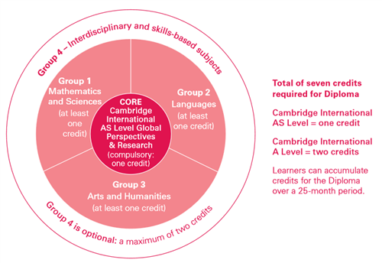
AICE Cambridge Diploma Requirements?
Must pass 7 AICE exams
First exam: May 2020
Final exam: May 2022
One exam in Math/Science
One exam in Humanities
One exam in Languages
AICE Global Perspectives
Additional three exams in any category

Slide 22
A day (or two) in the life of a 9th grader
English: AICE English General Paper
Social Studies: AP Human Geography
Math: Geometry H or Algebra 2 H (or higher)
Science: Biology H or Chemistry H (pre-req)
Elective #1: You choose!
Elective #2: You choose!
Elective #3: You choose!
Personalization Period/Study Hall
for the 2020-2021 school year

Slide 23
Additional information
Please look over our Cambridge PowerPoint for additional information

